Slide 1
Why Does My Computer Do That? Intro to Coding with Python– Welcome!
Dr. Ab Mosca (they/them)
Slides based off slides courtesy of Jordan Crouser (https://jcrouser.github.io/)

Slide 2
Plan for Today
Who am I?
Who are you?
What will we do in this class?
What is computer science / coding?

Slide 3



Who Am I?

Slide 4



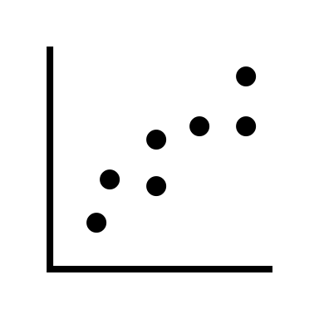

Who Am I?
Dr.

Slide 5



Who Am I?
Dr.

Slide 6
Who Are You?
Form groups of 3
Introduce yourselves (name, pronouns)
Share:
A highlight of your summer
Find 1 thing that your entire group has in common (favorite color? hometown? left-handed? Be creative!)
After about 5 minutes we will go around, introduce ourselves, and share what each group has in common

Slide 7
Who Are You?
Form new groups of 3 (move around!)
Introduce yourselves (name, pronouns)
Share:
Would you rather live in a mansion that you can never leave OR live in a camper van and move as often as you want?
Find 1 thing that your entire group has in common (favorite color? hometown? left-handed? Be creative!)
After about 5 minutes we will go around, introduce ourselves, and share what each group has in common

Slide 8
Who Are You?
Form new new groups of 3 (move around!)
Introduce yourselves (name, pronouns)
Share:
Would you rather have the ability to teleport OR have instant delivery on any online order?
Find 1 thing that your entire group has in common (favorite color? hometown? left-handed? Be creative!)
After about 5 minutes we will go around, introduce ourselves, and share what each group has in common

Slide 9
What You Will Learn & Logistics

Slide 10
What Is This Class?
An introduction to coding with the programming language Python assuming no prior knowledge of the subject
You will learn…
How to computationally approach problem solving
How to use basic programming constructs
How to code in Python
How a computer works, at a high level

Slide 11
**Important Info**
Course website (write this down!): https://amosca01.github.io/CAIS117-F23/
Slack: https://join.slack.com/t/mosca-cais117-f23/shared_invite/zt-20gsmo3na-WEzdyoDZVW0_kNSbv4Ul~g (please use slack for all course related communication)
OH’s: T/R 11:30 – 13:30 (stop by and say hi!)

Slide 12
**Important Info**
Textbook: Programming in Python 3 with zyLabs
See course website for instructions
Assignments:
Turn in with Gradescope (entry code - BBZ3BJ): https://www.gradescope.com/courses/557926
Homeworks – time to practice skills
In-class Activities – largely effort based
Final Project – group based, application of skills
Optional Midterm – can only help your grade
Due Dates: As listed on course schedule.
24hr grace period; no late submissions
Lowest homework dropped
No regrades; see syllabus for revise and resubmit instructions

Slide 13
**Important Info**
I’m here to help you succeed
Please come to office hours or reach out on Slack if you need any additional support

Slide 14
Now the good stuff

Slide 15
What is a Computer?

Slide 16
What is a Computer?
A “computer” performs computations

Slide 17
Computation (def.)
“a sequence of well-defined operations
that lead from an initial starting point
to a desired final outcome”
+
–
÷
×
AND
OR
XOR
NOT
mathematical
logical
Notes:
note this definition does not include the word “computer”
a computation is a process that can be carried out by a person or a machine
the same computation might be carried out using any one of a number of different technologies

Slide 18
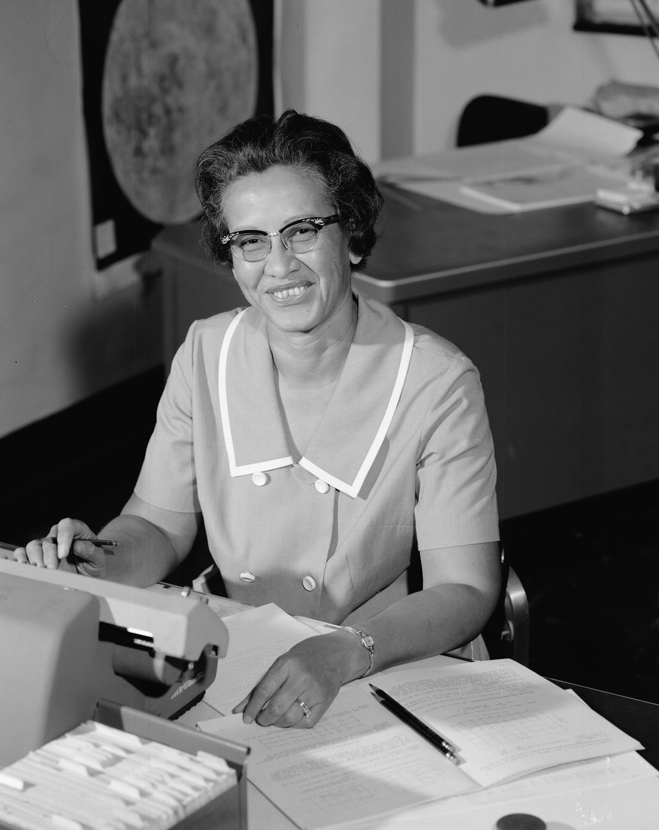
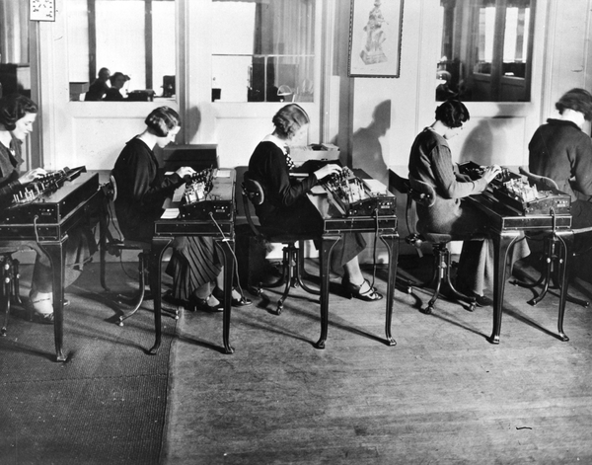
Original “Computers”
Katherine Johnson
Keypunch operators at IBM in Stockholm in the 1930s.
https://www.nytimes.com/2019/02/13/magazine/women-coding-computer-programming.html
Notes:
Original Computers were women who did computations

Slide 19
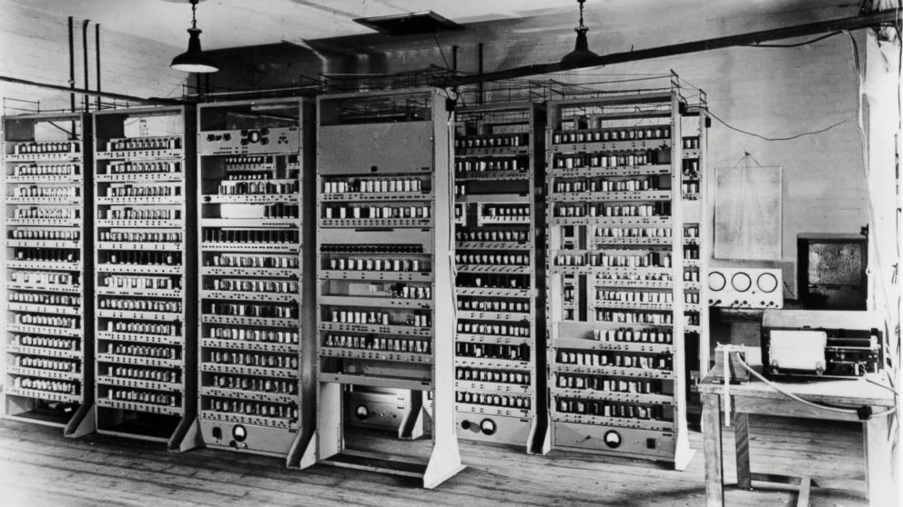
First Electronic Computer
https://abcnews.go.com/Technology/blast-past-part-belonging-worlds-computers-found/story?id=28697624
Notes:
The ENIAC (1945) was the first electronic general-purpose digital computer; it filled a room
When computers first started being widely used in the 1950s the general public viewed them as “electronic brains”
they were huge, expensive, mysterious
found only in the largest corporate, government, or university labs
sci-fi movies exploited this “electronic brain” viewpoint

Slide 20

First Electronic Computer
https://www.nytimes.com/2019/02/13/magazine/women-coding-computer-programming.html
https://abcnews.go.com/Technology/blast-past-part-belonging-worlds-computers-found/story?id=28697624
Notes:
Does this machinery contain the same specialized knowledge of a human?

Slide 21
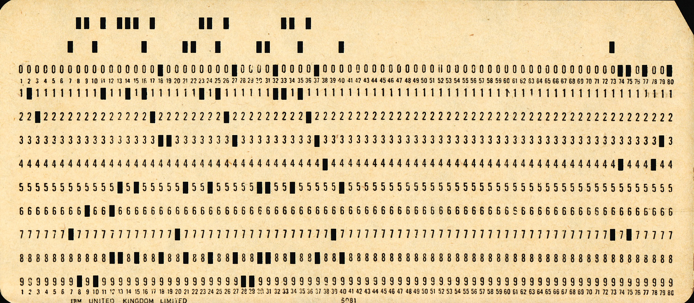
First Electronic Computer
https://en.wikipedia.org/wiki/Punched_card#/media/File:Used_Punchcard_(5151286161).jpg
Notes:
Does this machinery contain the same specialized knowledge of a human?
Absolutely not! It is a machine, therefore needs to be told exactly what to do
The way that was done was with punch cards! They encoded information with punched out holes, that provided instructions and data to the machine

Slide 22
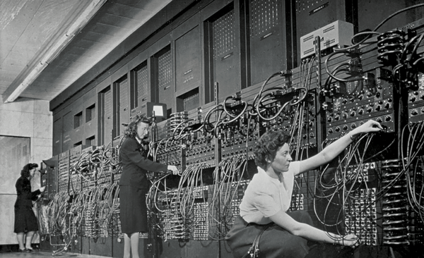
Original “Computers”
Computer operators with an Eniac — the world’s first programmable general-purpose computer.
https://www.nytimes.com/2019/02/13/magazine/women-coding-computer-programming.html
Notes:
But remember! Computers were used for highly specialized calculations, therefor whoever wrote those instructions needed to have that highly specialized knowledge!
The people with that specialized knowledge were the original computers!
It was seen as natural that they would be the ones to tell computers what to do once we had them
Also, telling the computer what to do (as opposed to building the machinery) was seen as a lesser job at the time

Slide 23
Original “Computers” Programmers
Computer operators with an Eniac — the world’s first programmable general-purpose computer.
https://www.nytimes.com/2019/02/13/magazine/women-coding-computer-programming.html
Notes:
Those highly trained people were mostly women!
It was seen as natural that they would be the ones to tell computers what to do once we had them
Why did Women fall out of coding?
At a certain point it was split between women and men, then colleges started offering CS
Boys were often exposed to and encouraged to do CS at home, girls were not
Academia is sexist and women were not treated well in college or as likely to go to college
As coding became more popular, courses got too full and ”weed out” classes became a thing
”Weed out” class success is largely dependent on prior exposure to coding, not aptitude, so boys tended to do better
This led to a culture shift, that was backed up by popular culture portrayals of CS (ex. movies)
Eventually the culture became engrained, hostile to women and other minoritized groups, and we’re still working to make it better today

Slide 24


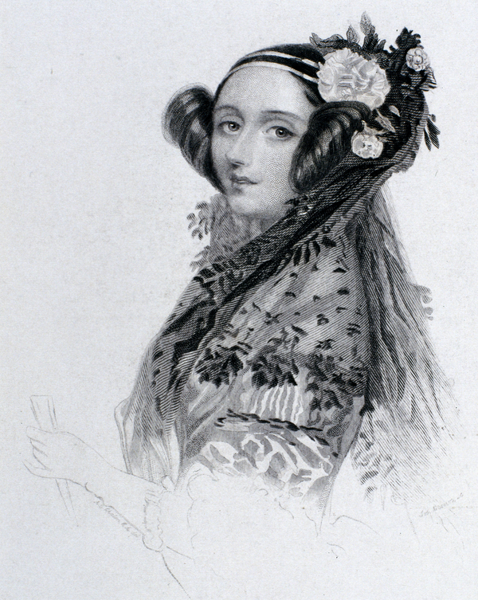
Programmers
Computation: a sequence of well-defined operations that lead from an initial starting point to a desired final outcome
Ada Lovelace, the first programmer
NOT
AND
OR
logical
https://www.nytimes.com/2019/02/13/magazine/women-coding-computer-programming.html
Notes:
Programmers are people who write the map or instructions that tell computers what to do
In other words, they

Slide 25
Activity: computational thinking
Notes:
To explore this idea more concretely, let’s look at an example.
Everyone find a partner, and take a tractor.

Slide 26

Activity: computational thinking
FWD
R90
Notes:
This is Tango the tractor. Tango knows two operations: she can drive forward 10 feet, and she can turn 90 degrees to the right.

Slide 27
Activity: computational thinking
10ft
Task 1

Slide 28
Activity: computational thinking
10ft
10ft
Task 1
Task 2

Slide 29
Activity: computational thinking
10ft
10ft
the 1st letter of your first name
Task 1
Task 2
Task 3

Slide 30
Discussion
What do you notice?
Were there any letters you couldn’t draw?
Can you tell in advance which shapes are impossible?
Notes:
Even though this example was a little silly, it illustrates many of the themes that today typify theoretical computer science. You have some well-defined set of allowed operations. Using those operations, you build all sorts of beautiful and complex structures—often reusing structures you previously built to build even more complex ones. But then certain kinds of structures, it seems you can’t build. And at that point, you have to engage in metareasoning. You have to step back from the rules themselves, and ask yourself, what are these rules really doing? Is there some fundamental reason why these rules are never going to get us what we want?

Slide 31
Computer science (def.)
“the study of computation”
Problems that can be solved computationally
Languages used to describe computational processes
Machines that carry out those processes
Theoretical limits of computation
Computational solutions to problems in math, science, medicine, business, education, journalism, ...

